Slide 1
Predicting the Nightly Rate of Airbnb Listings in Austin, TX
Capstone Project I for Springboard
Louie Balderrama
January 2019 Cohort

Slide 2
Background
Airbnb has become the biggest disrupter of the hospitality and tourism industry
The study will take a look at the different aspects of Airbnb listings to see what features will most accurately predict the nightly rate of a stay
Focus on the city of Austin – the tech-capital of Texas
Will also incorporate data on the crimes reported in the area
Limitations:
Study assumes conventional rates
Surge in demand from popular events and its effect on price will not be covered

Slide 3
Impact
A reliable model can benefit both hosts and guests
Hosts would have a good rule of thumb in pricing a nightly stay given the nature of the space, the nature of the booking, the location, etc.
Hosts would therefore minimize opportunity cost by not missing out on bookings from guests who would have otherwise been offered a fair price
Guests would have a reliable indicator of what a fair deal would look like
The industry itself could see a positive impact from an optimized, competitive host-guest marketplace

Slide 4
Datasets
Airbnb Listings
All ~12,000 Austin, TX Airbnb listings as compiled on November 2018
Raw, noisy, messy, lots of NaNs
Austin, TX Crime
All 100,000+ reported crimes in Austin, TX during 2018
The ~36,000 major crimes are classified by FBI standard: Theft, Auto Theft, Burglary, Robbery, Rape, Aggravated Assault, and Murder
Zip Codes
GeoJSON dataset for plotting choropleth map

Slide 5
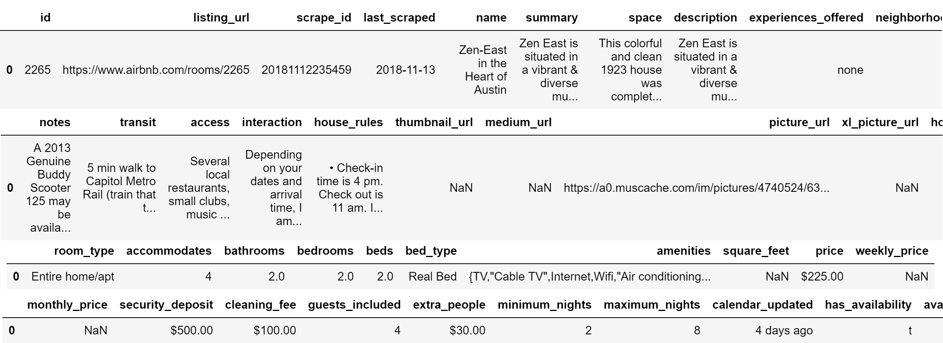
Data Wrangling – Airbnb Dataset
Rich in information with 96 columns

Slide 6
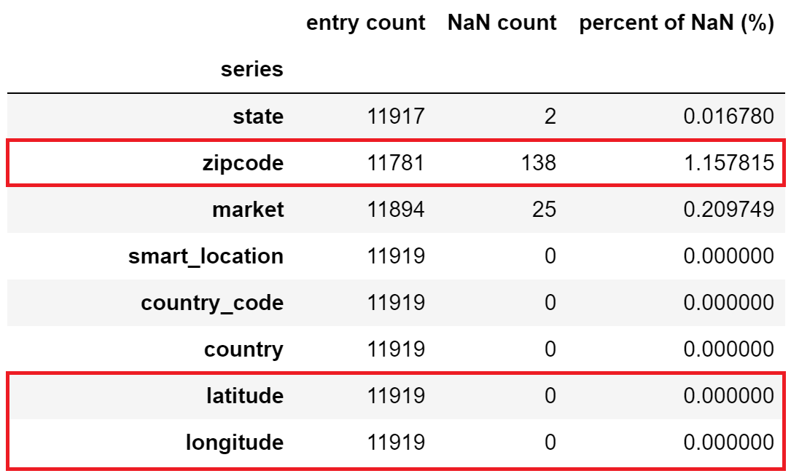
Data Wrangling – Airbnb Dataset
Can be linked to crimes dataset using location but zipcode column has missing values
However, latitude and longitude all have real values
MapQuest API was used to reverse geocode the coordinate points to fill the missing zipcode values

Slide 7
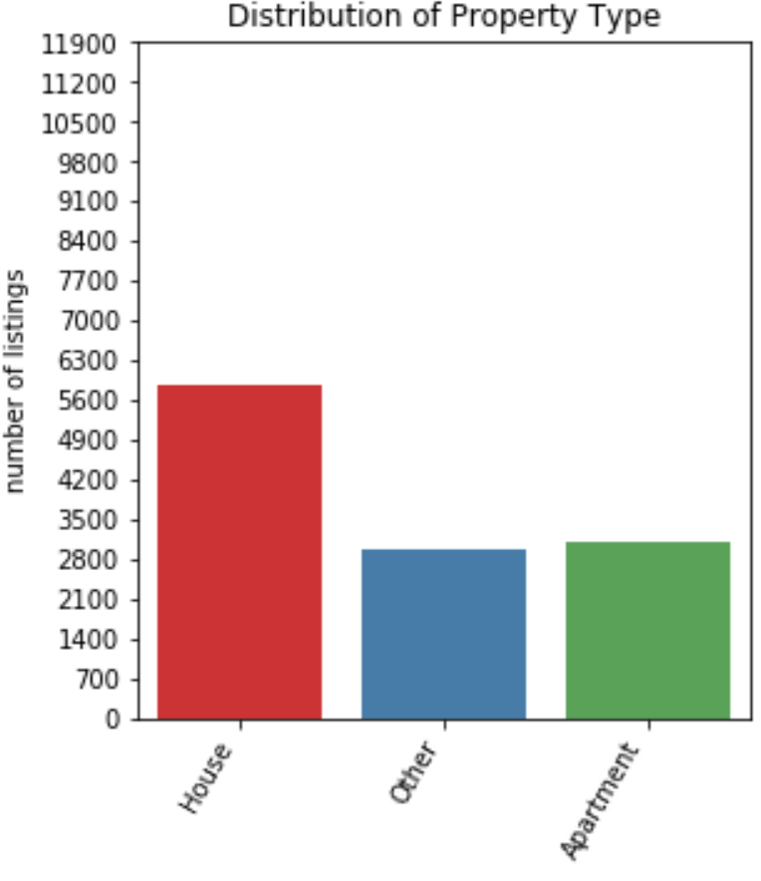
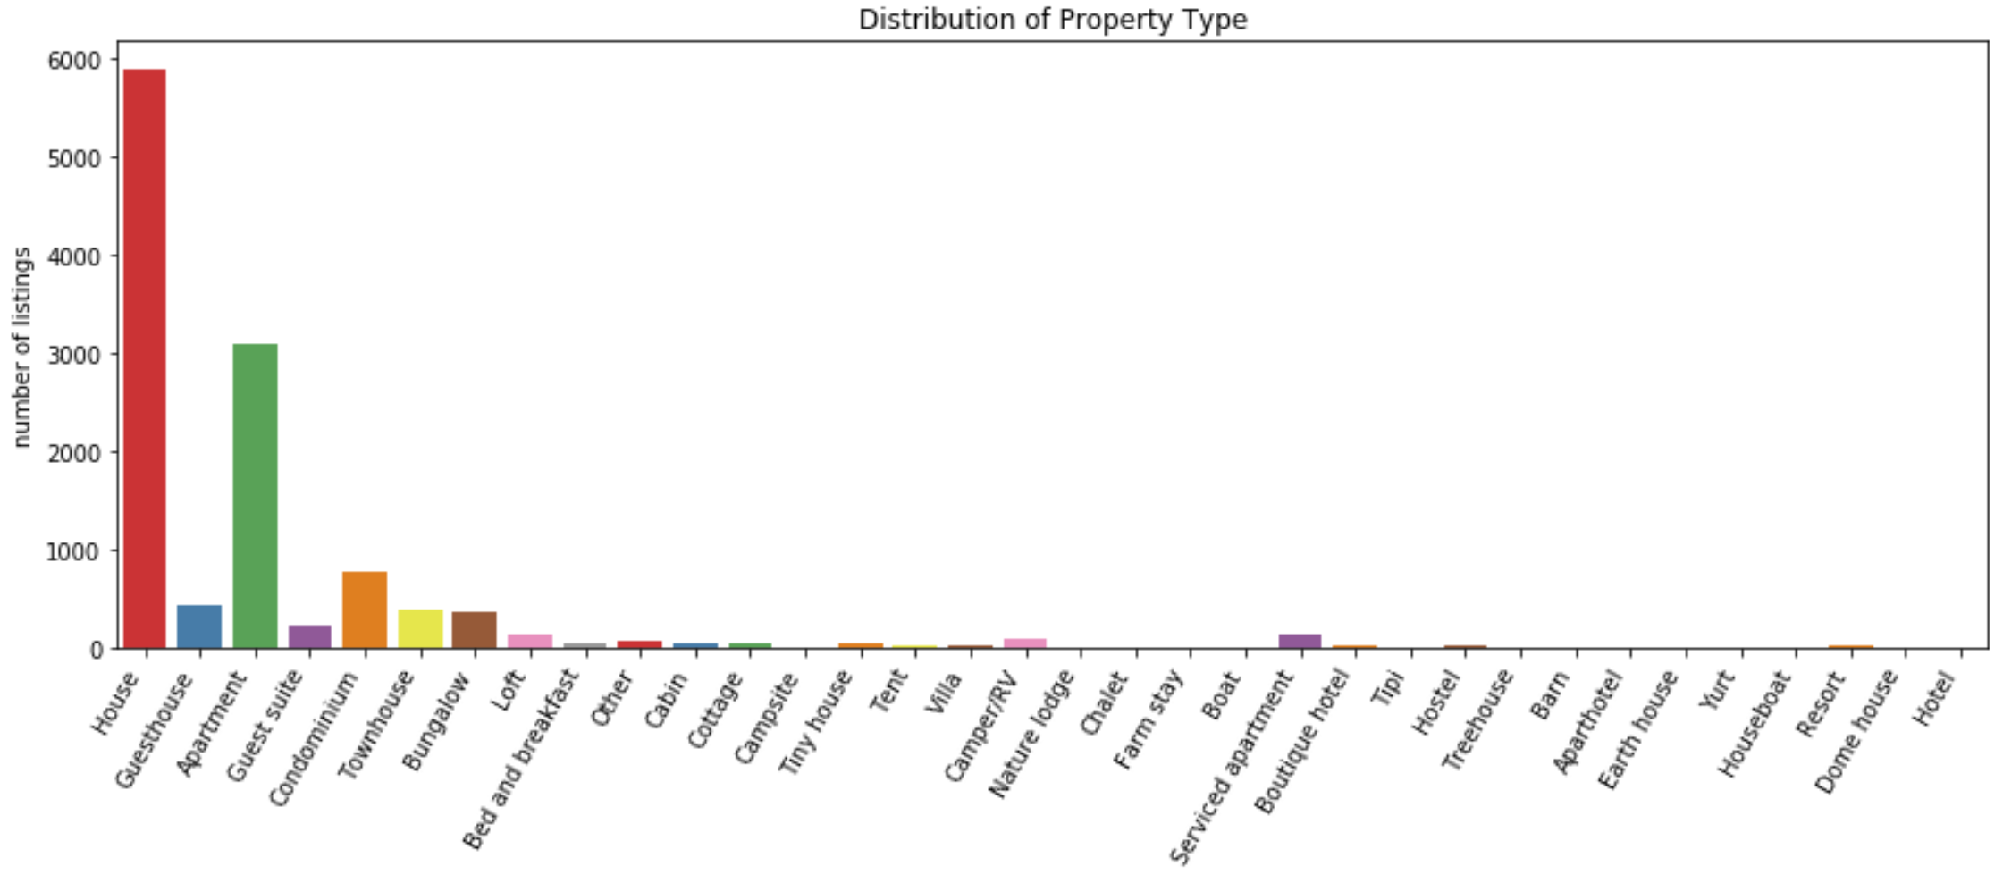
Feature Engineering – Airbnb Dataset
Categorical features were simplified by reducing number of classes

Slide 8
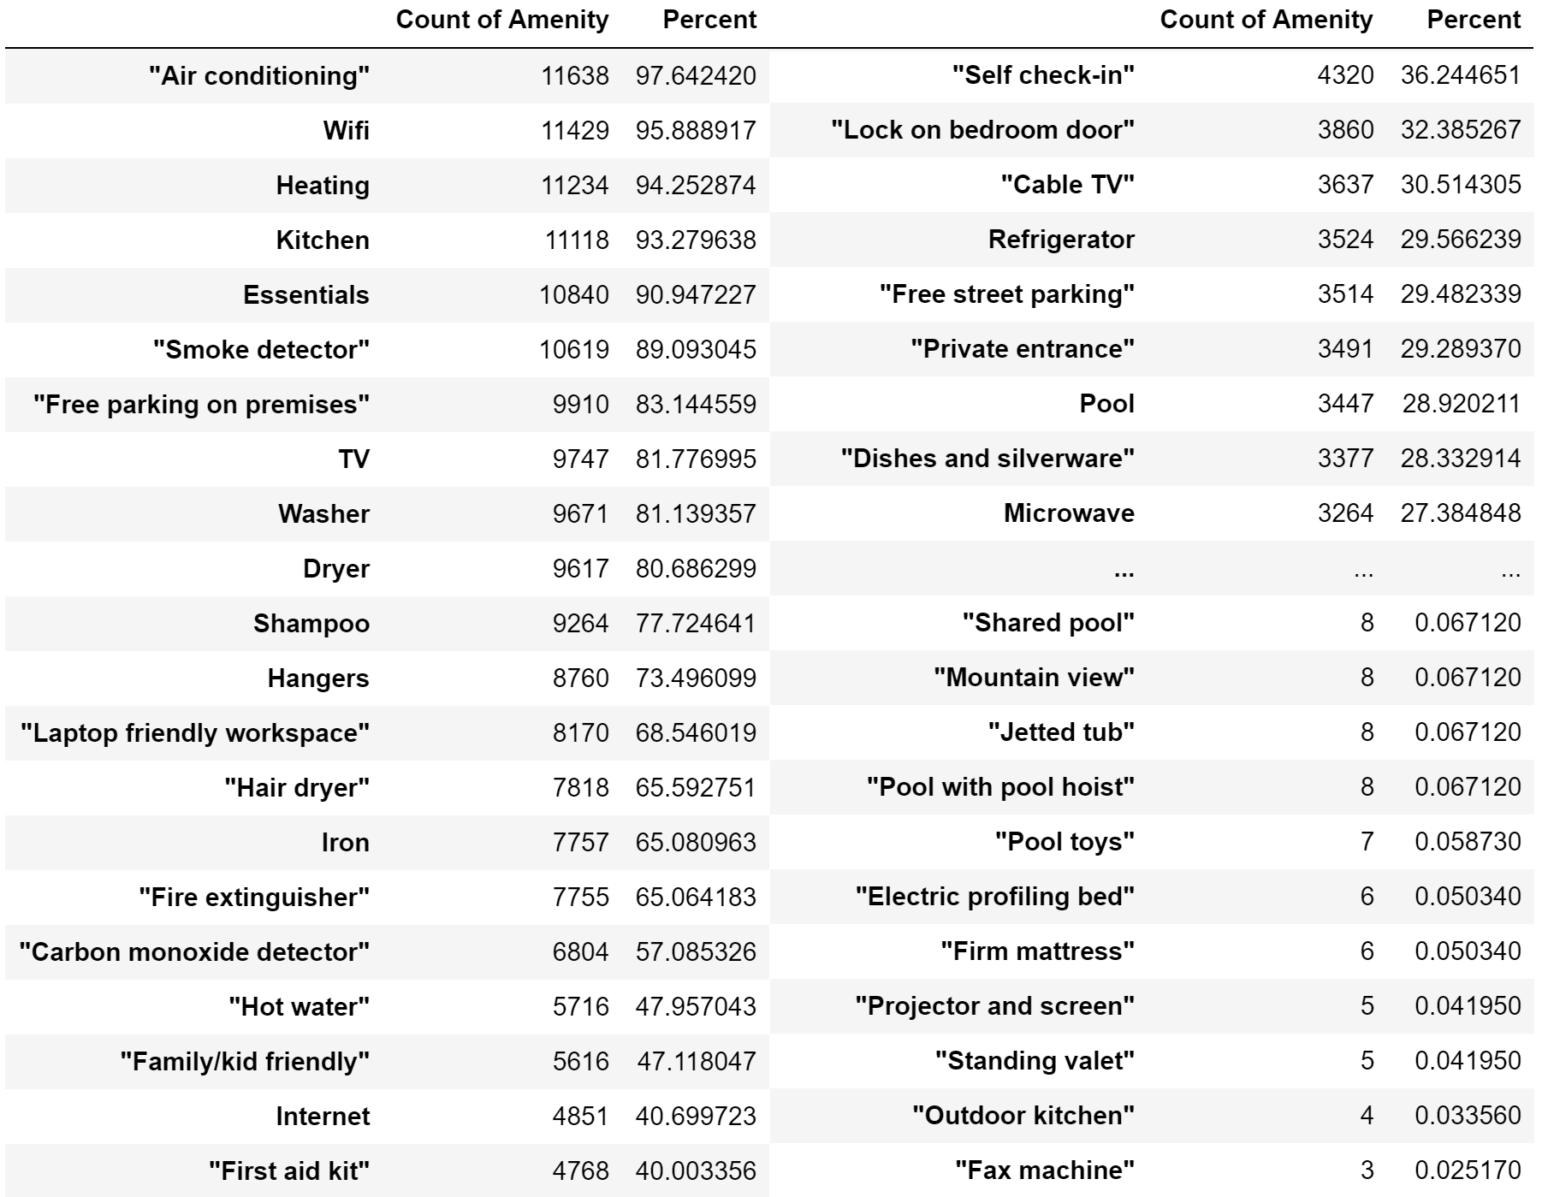
Feature Engineering – Airbnb Dataset
The amenities column is a nested JSON that lists all the attributes a host claims a property has

Slide 9
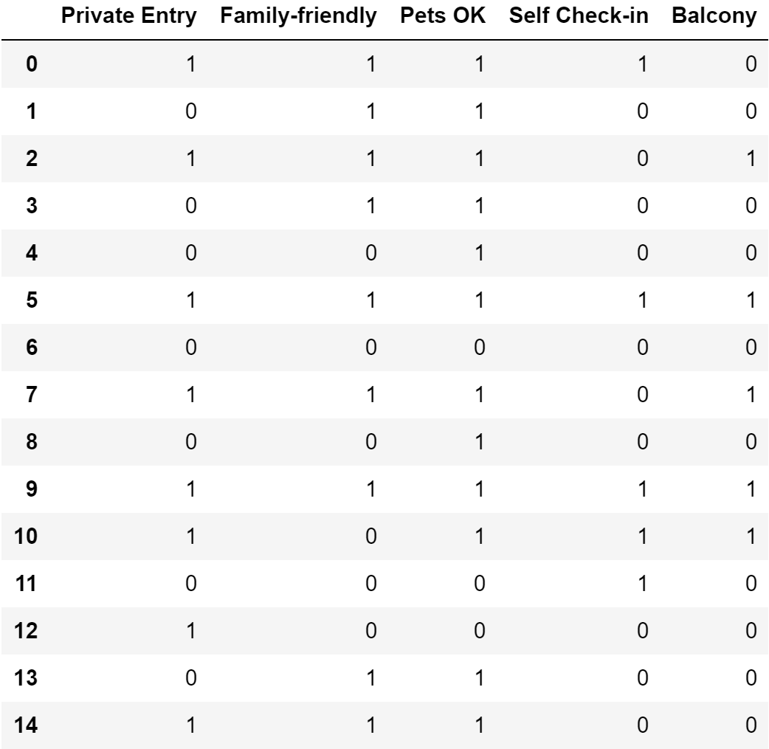
Feature Engineering – Airbnb Dataset
Five amenities are selected because they have varying distributions that do not represent most or almost none of the listings

Slide 10
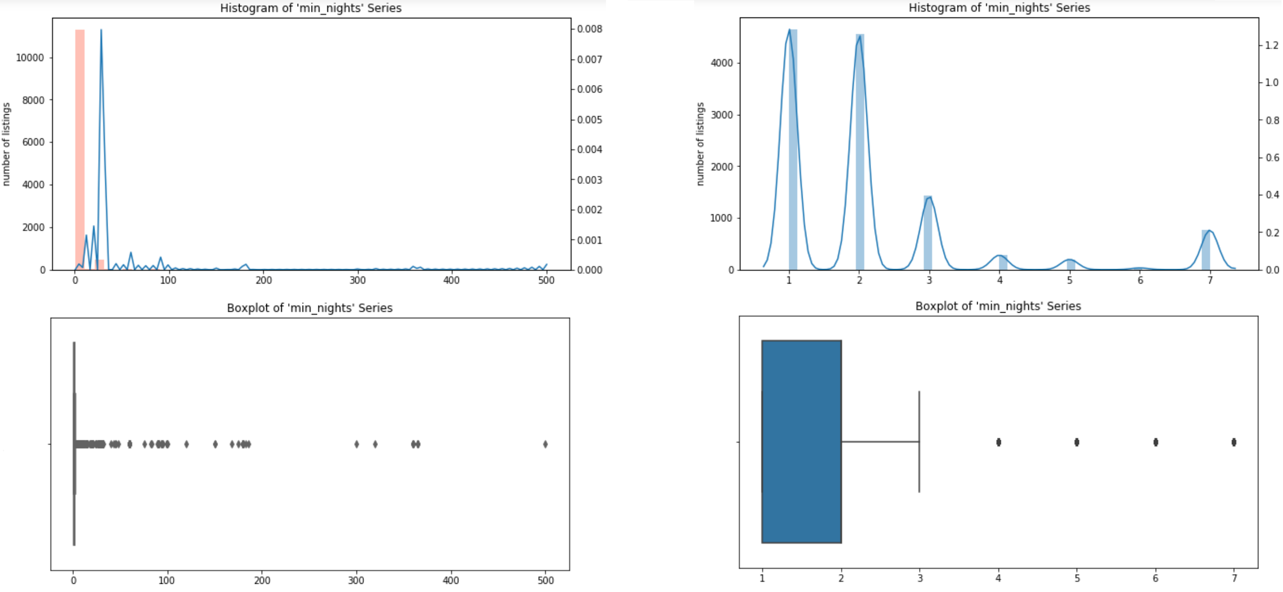
Feature Engineering – Airbnb Dataset
Outliers of continuous features were clipped according to distribution

Slide 11
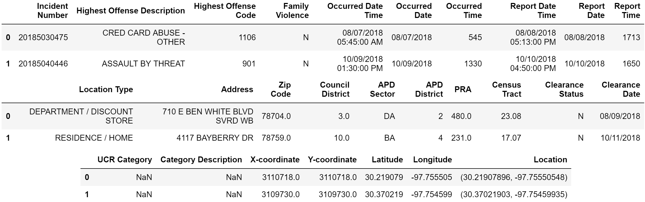
Data Wrangling – Crimes Dataset
Total of 27 columns

Slide 12
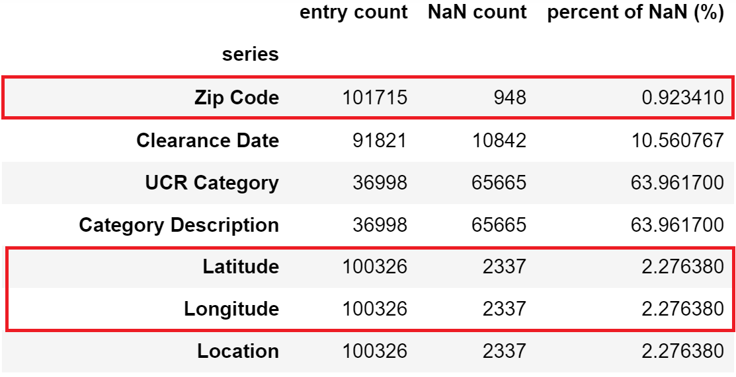
Data Wrangling – Crimes Dataset
Again, MapQuest API was used to get missing Zip Code values
Not all entries have Latitude and Longitude but a total of 181 missing Zip Code values were filled because of this technique
Entries missing these information are dropped since they cannot be related to the listings dataset in any way

Slide 13
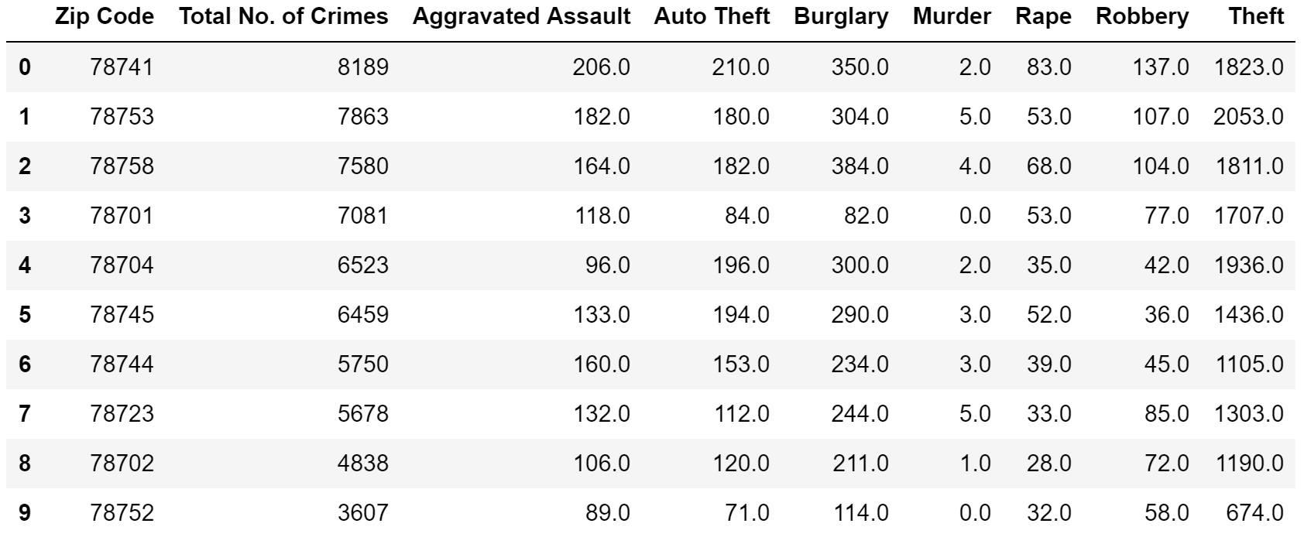
Feature Engineering – Crimes Dataset
Observations are grouped by Zip Code and aggregated by count
Entries are also pivoted by UCR Category (for major crimes only)

Slide 14
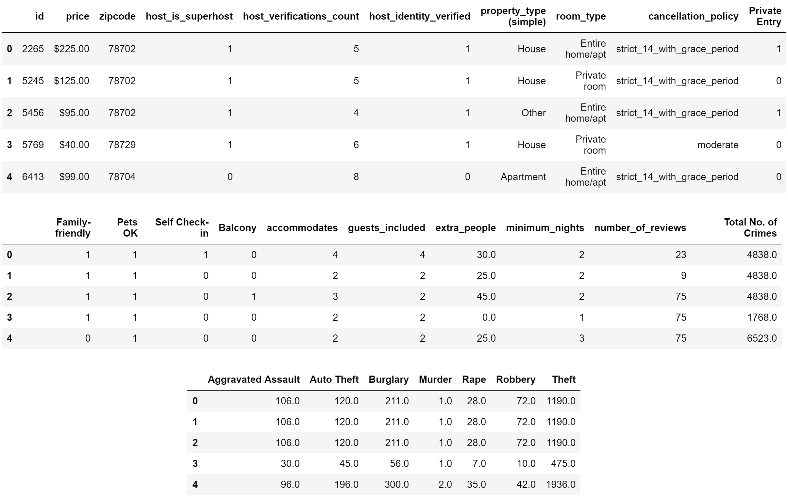
Combining Listings and Crimes Datasets
The df dataframe is created by joining listings and crimes left-wise

Slide 15
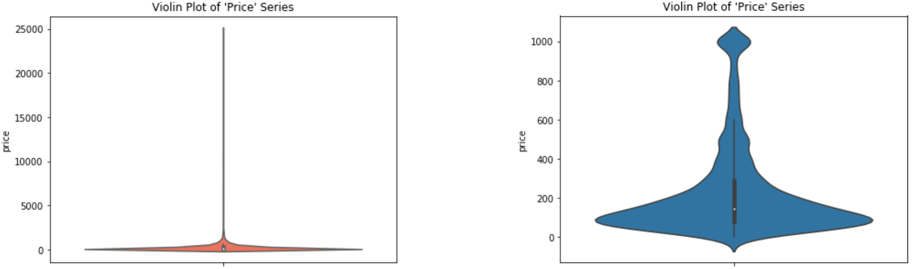
Price – The Target Variable
Invalid price entries (denoted as 0, not NaN) are dropped
Nightly rate clipped at $1,000 per night
Final df has 25 predictor features and 11,908 entries

Slide 16
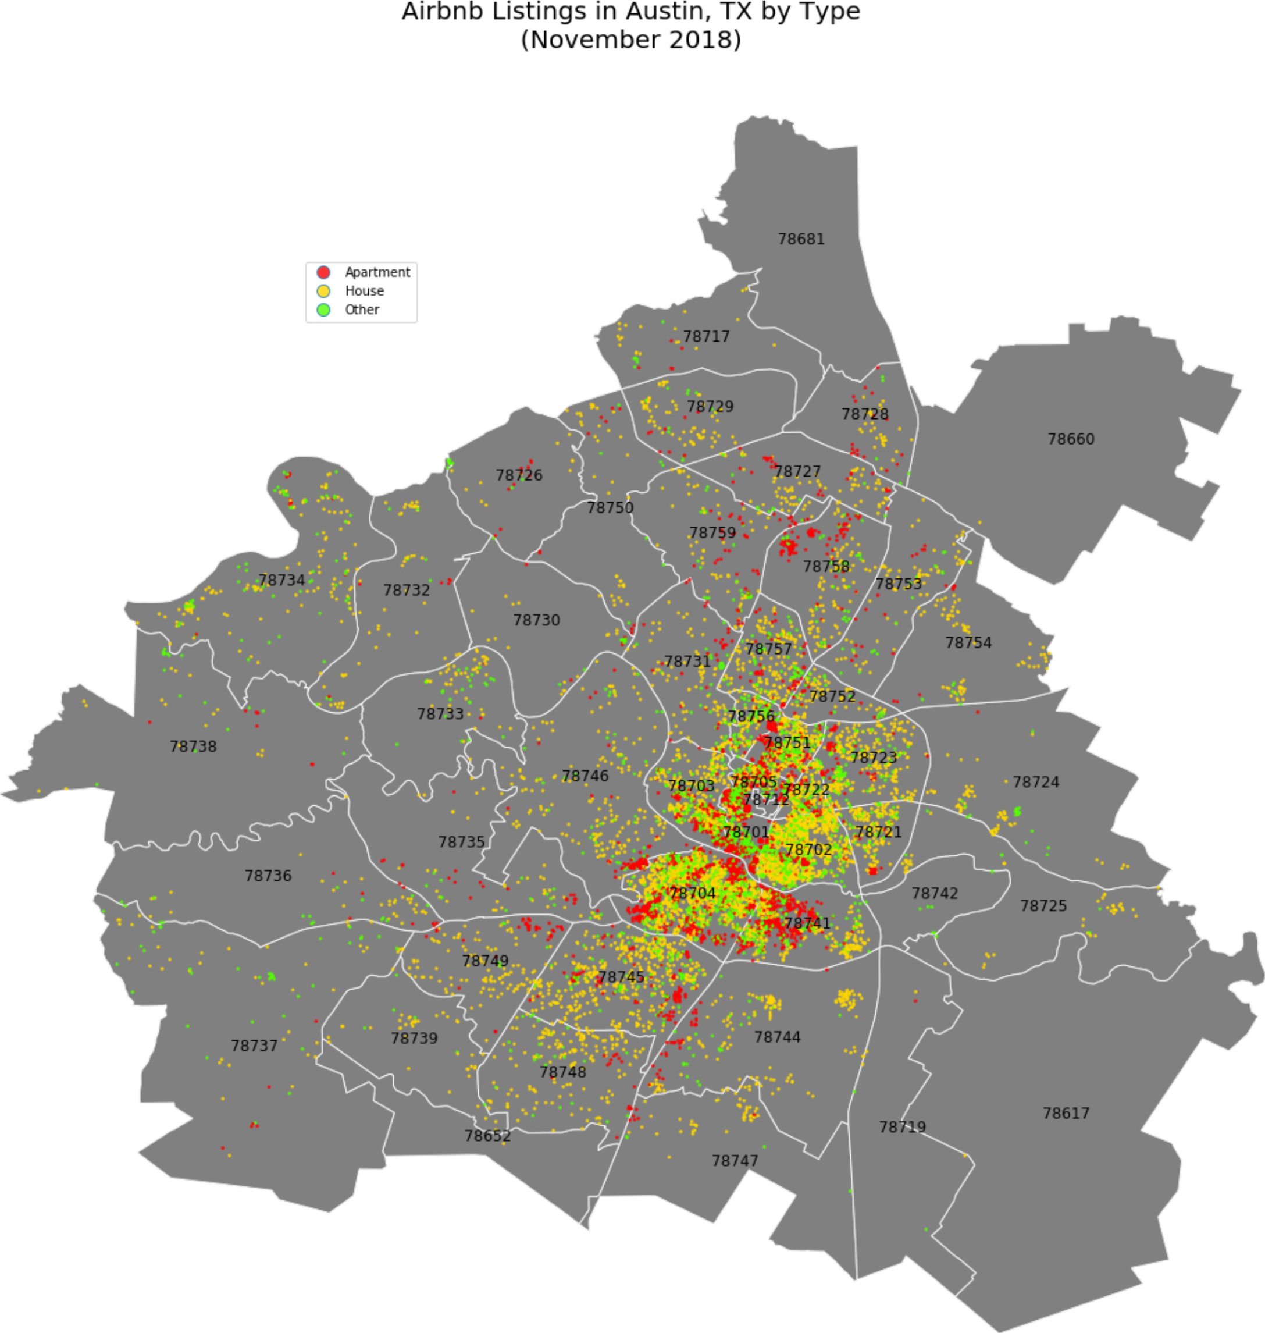
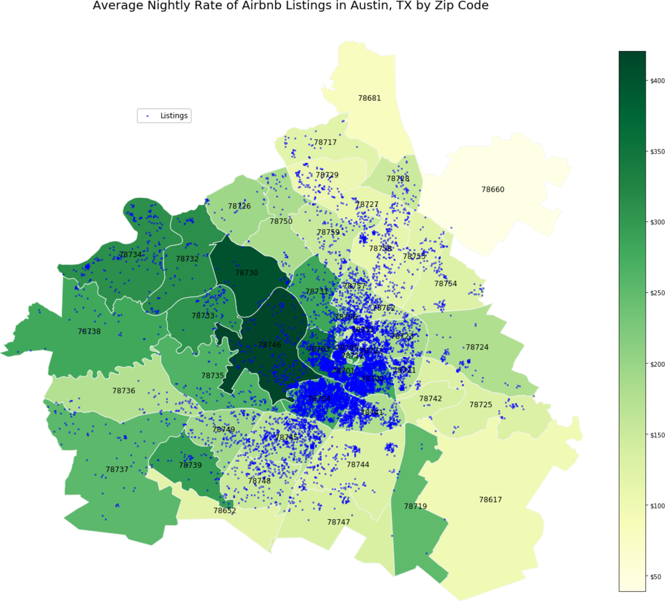
Exploratory Data Analysis

Slide 17
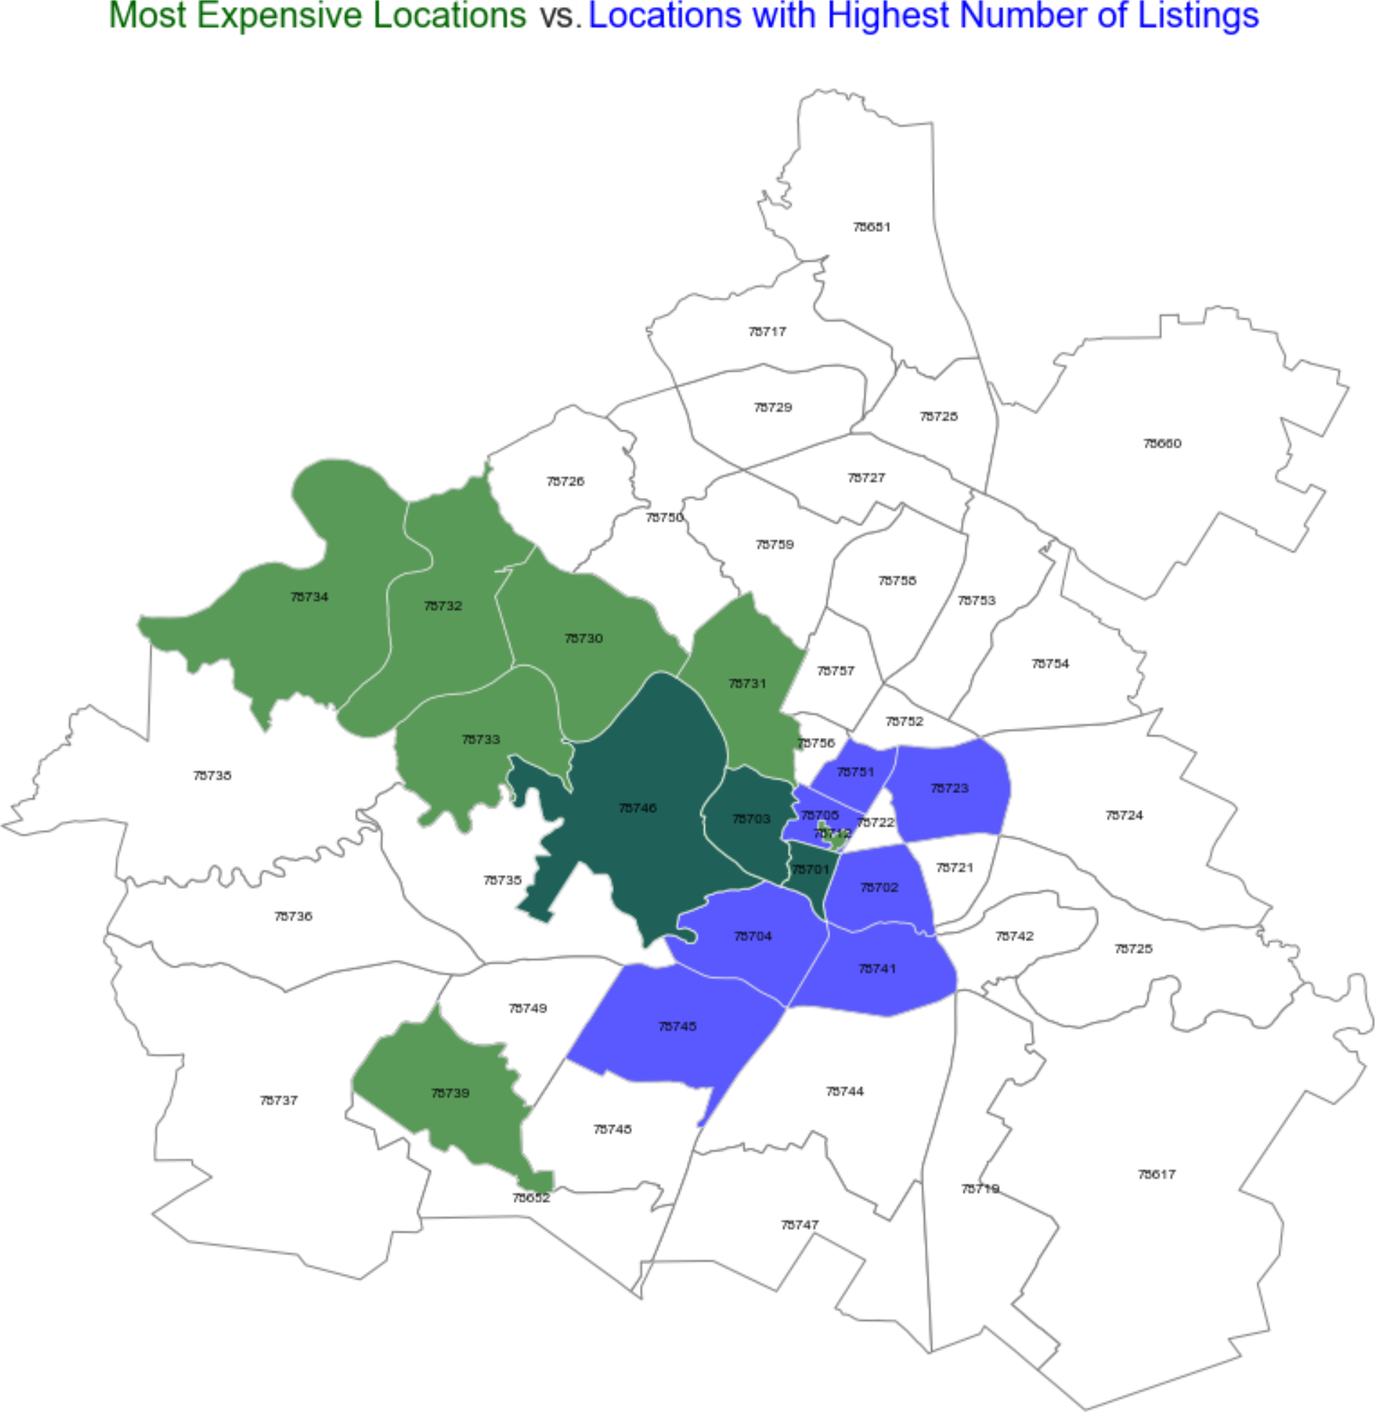
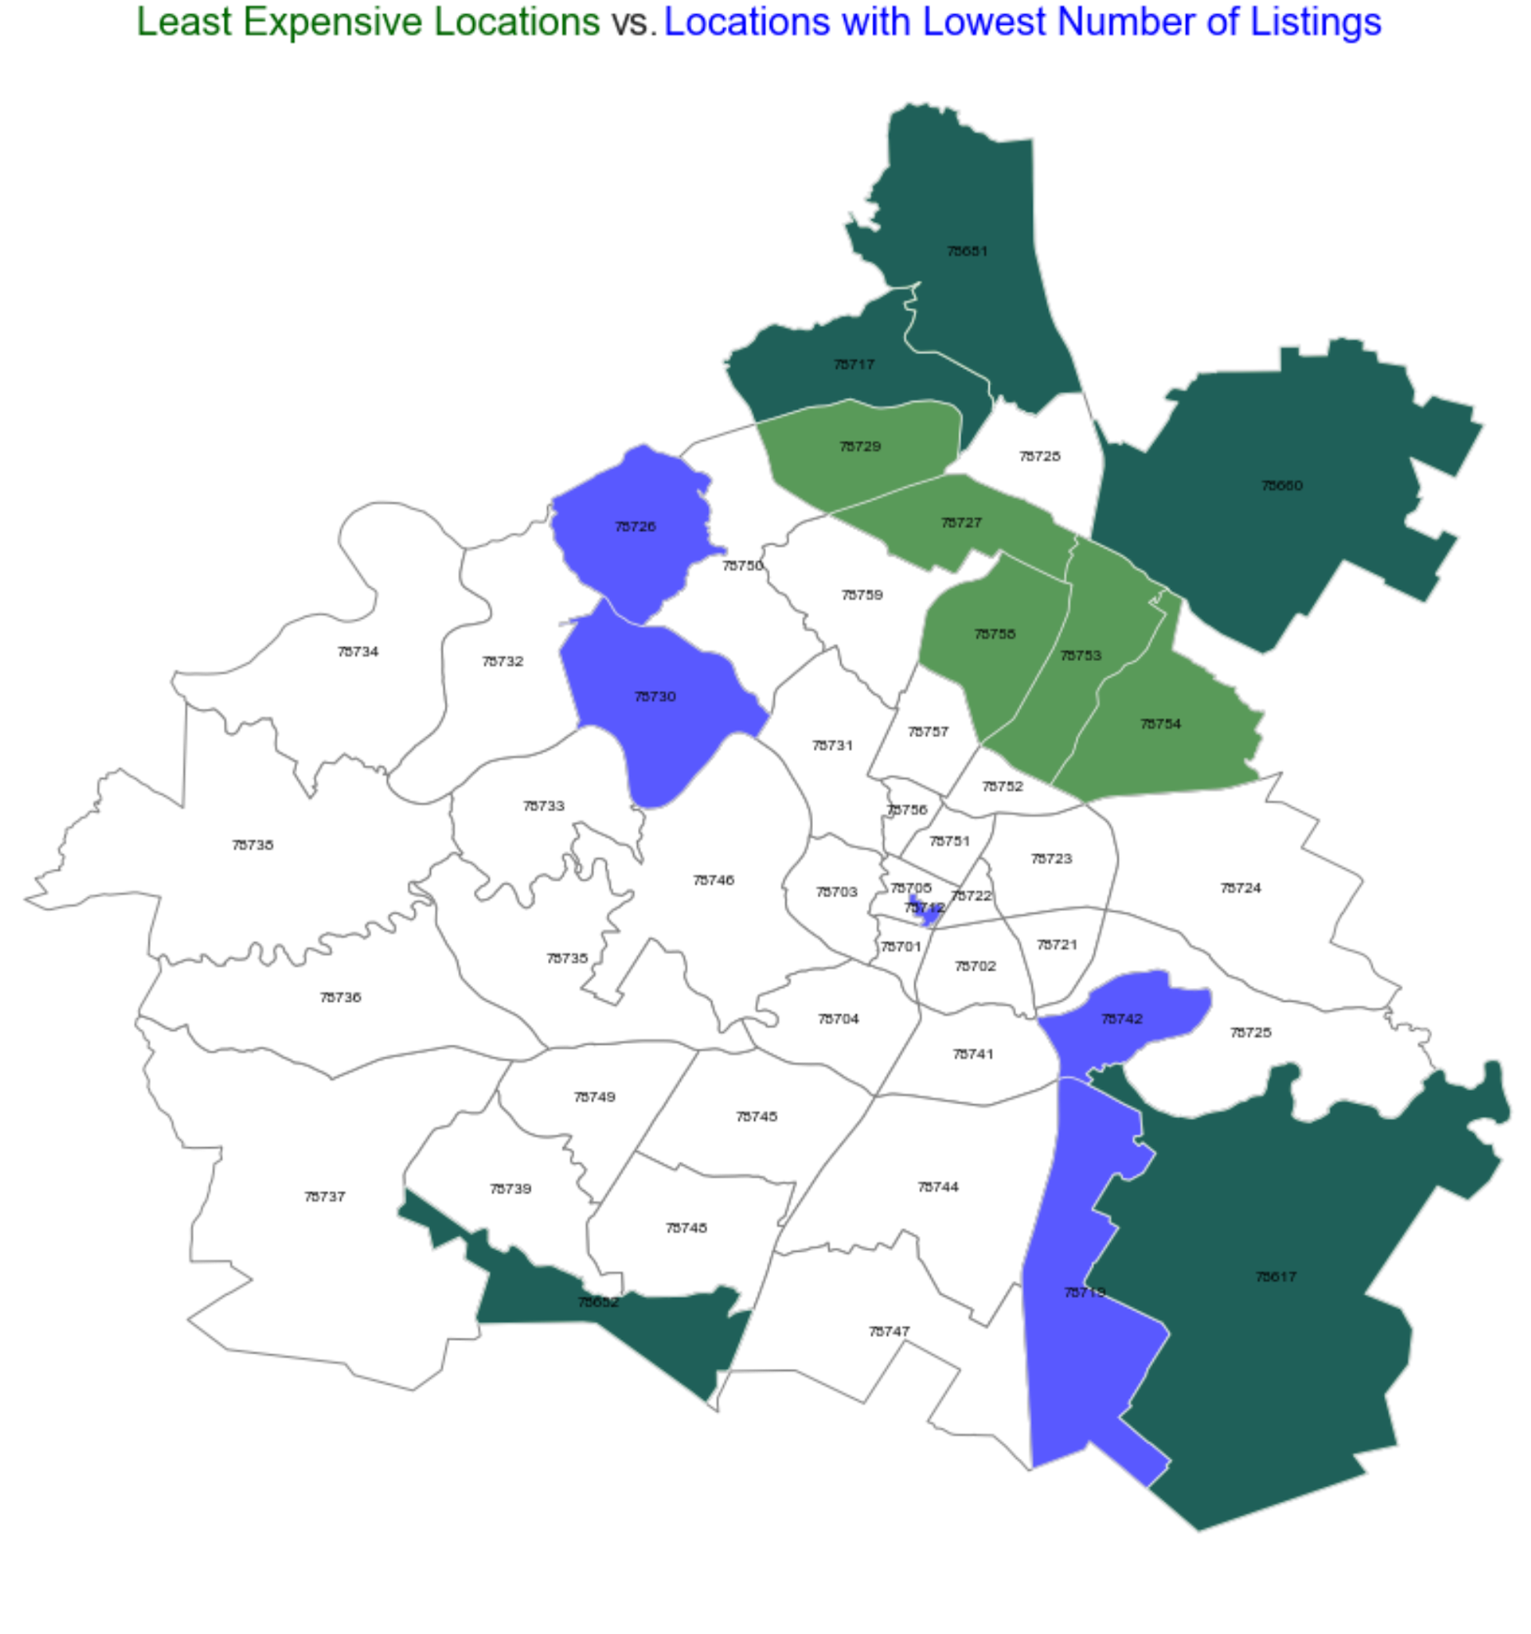
Exploratory Data Analysis

Slide 18
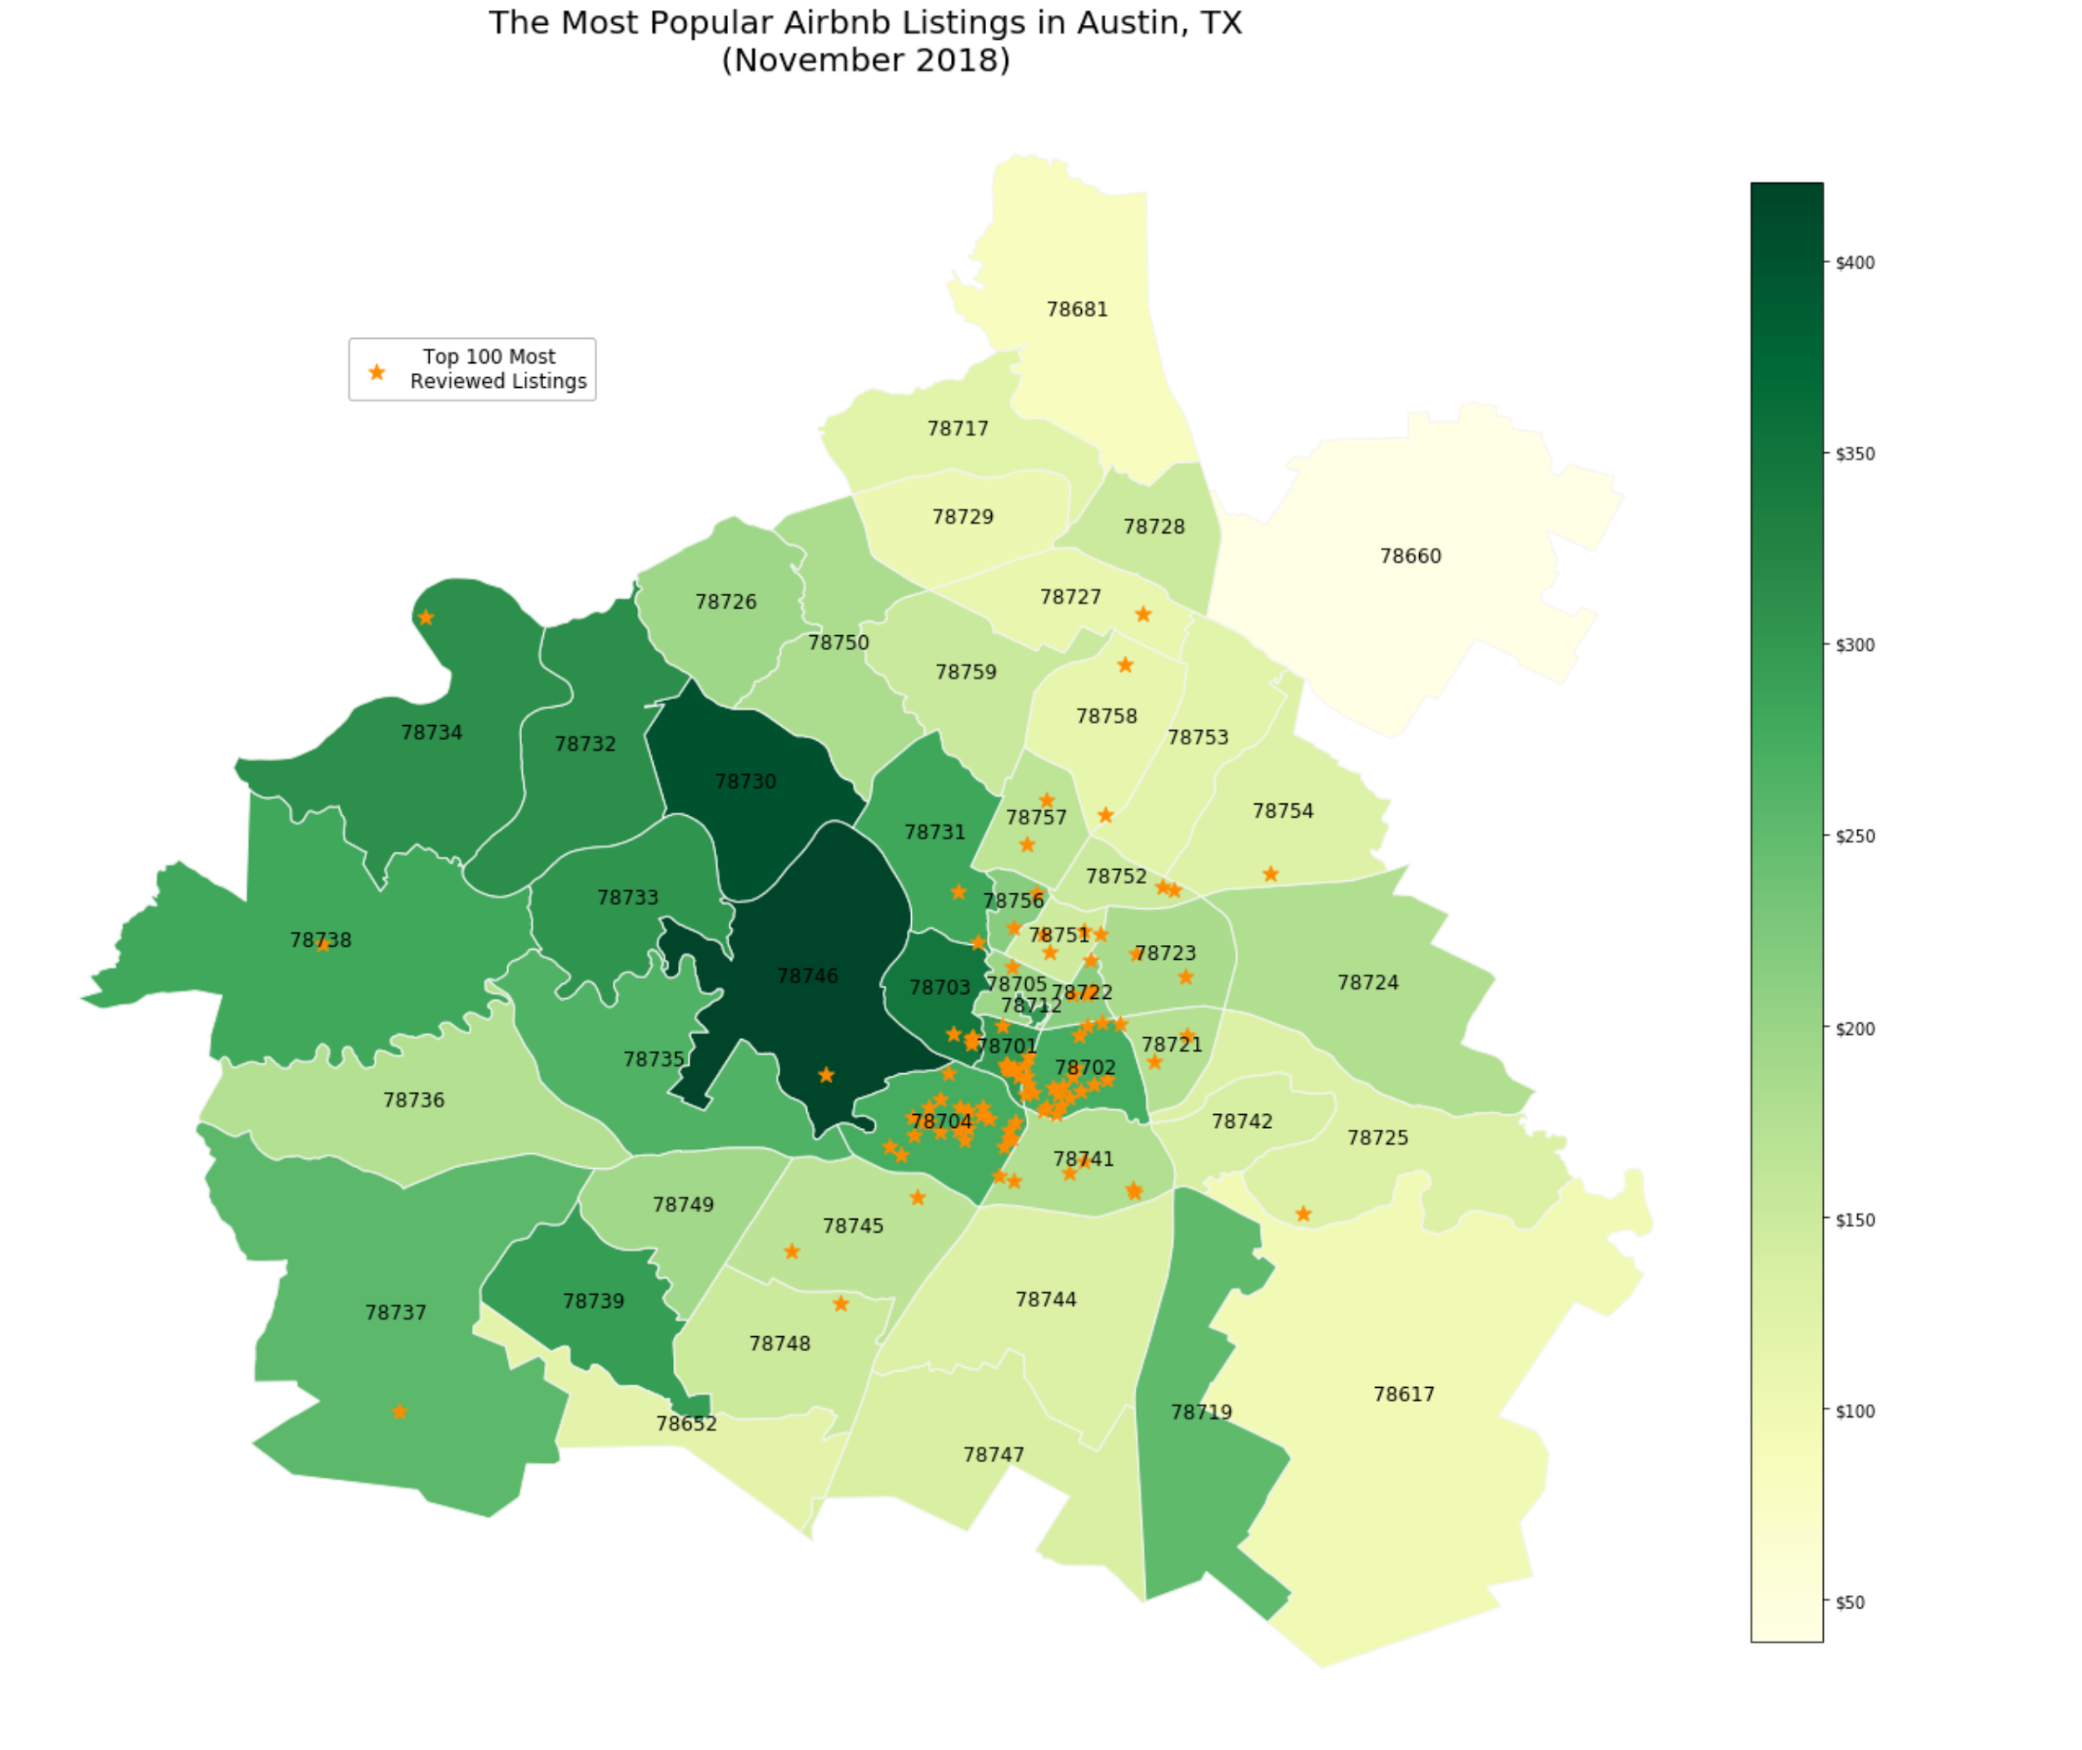
Exploratory Data Analysis

Slide 19
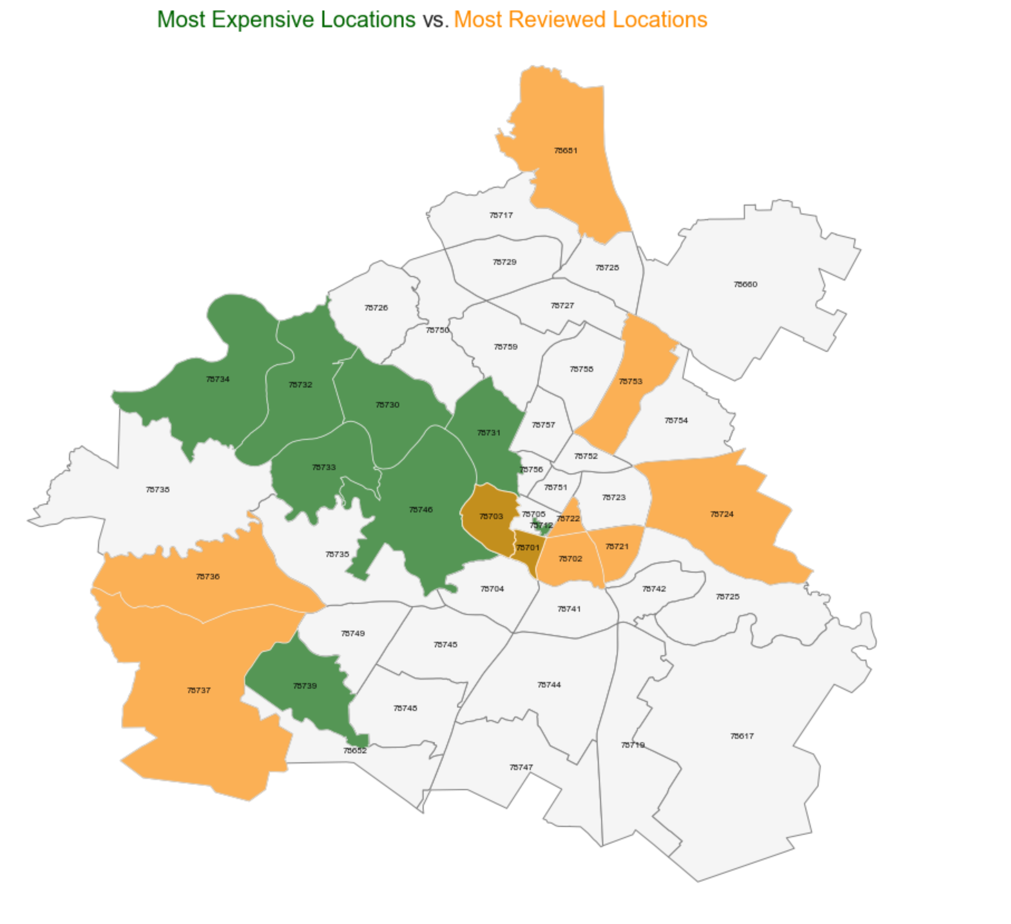
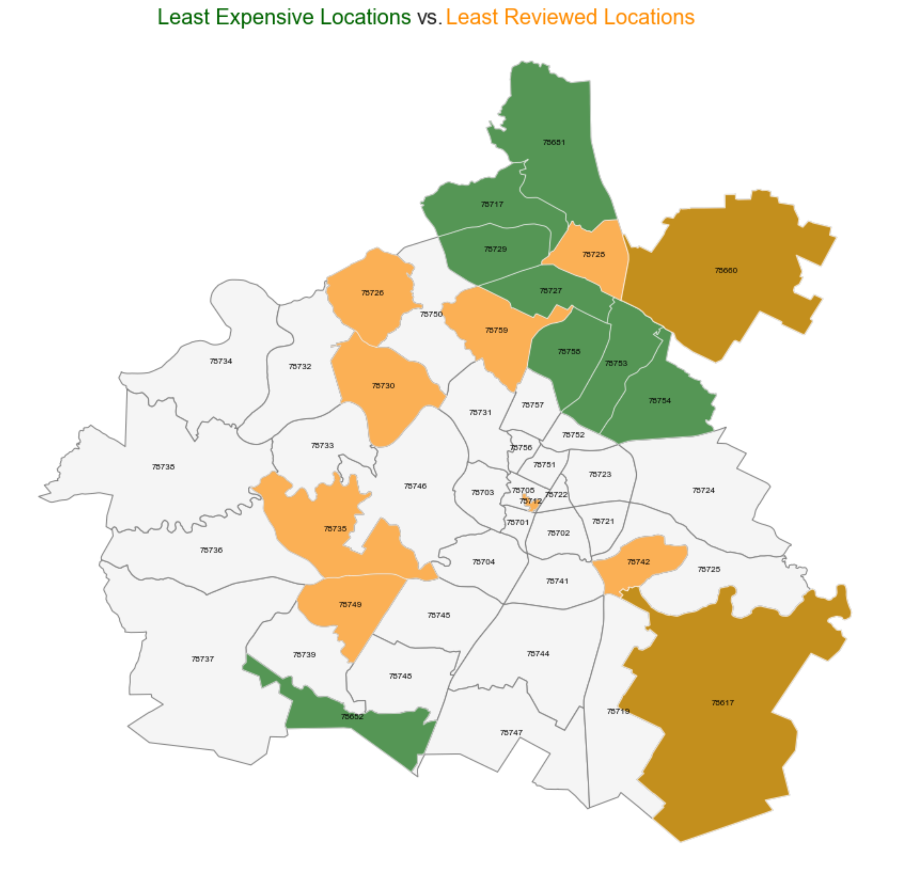
Exploratory Data Analysis

Slide 20
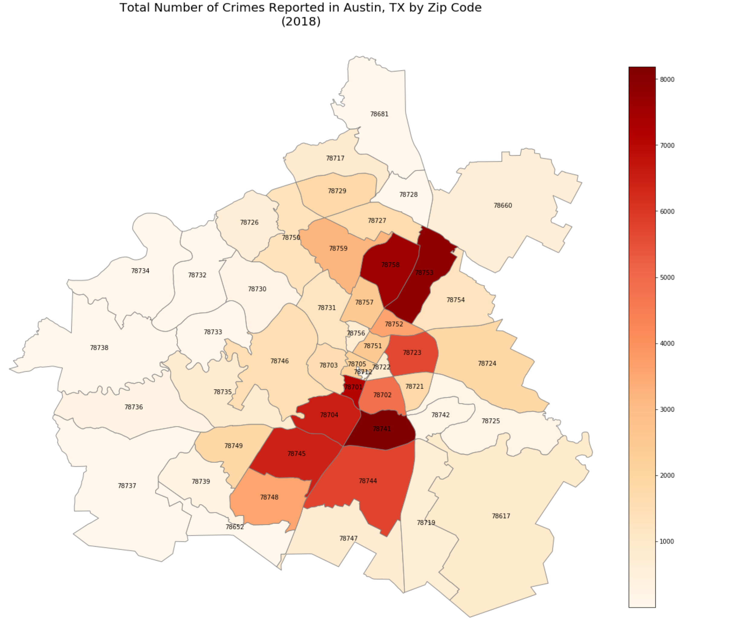
Exploratory Data Analysis

Slide 21
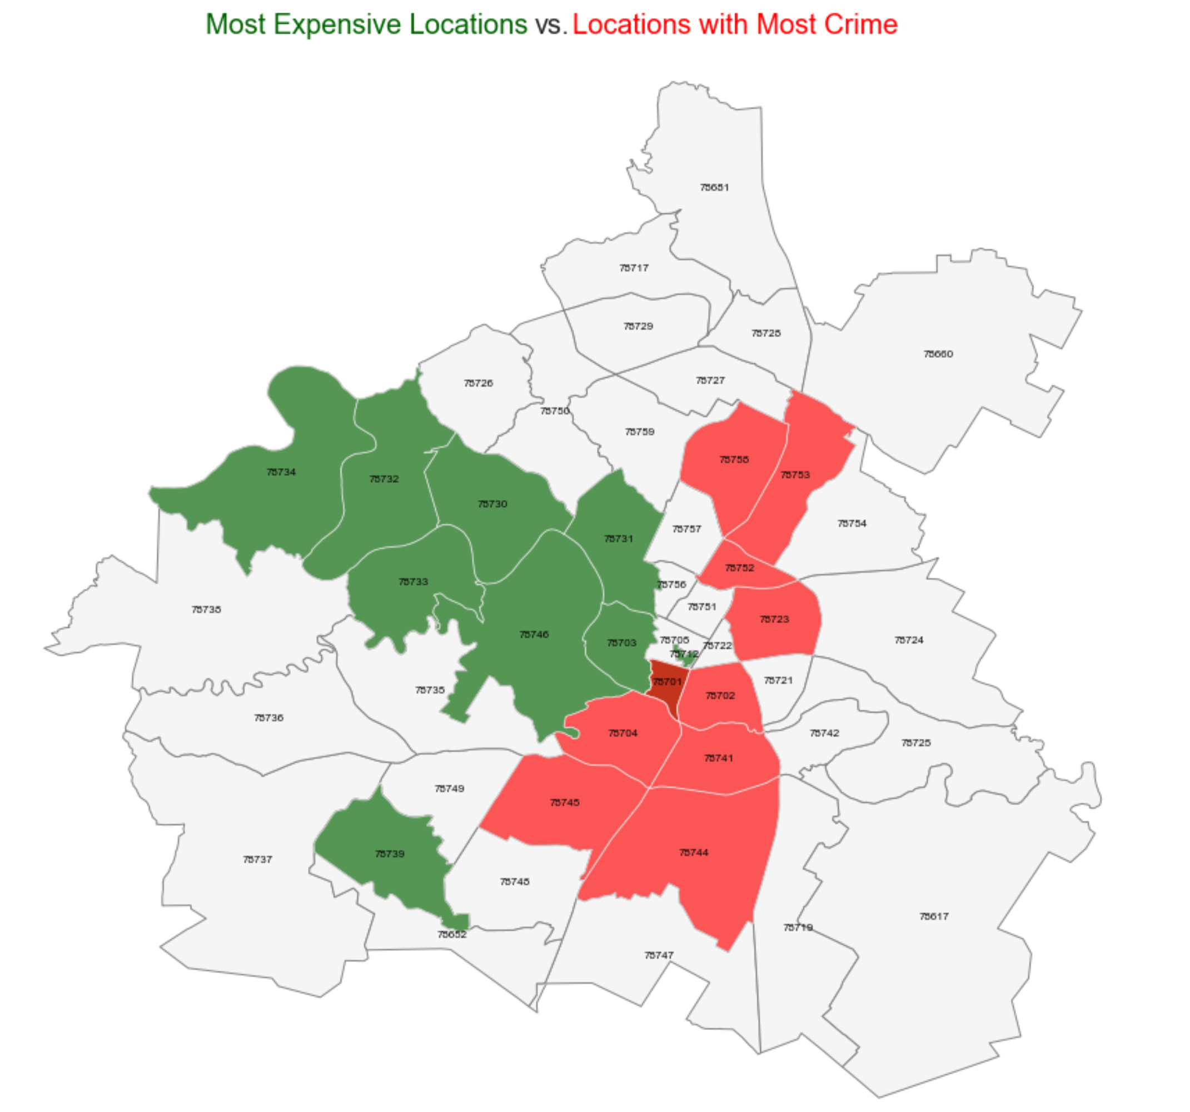
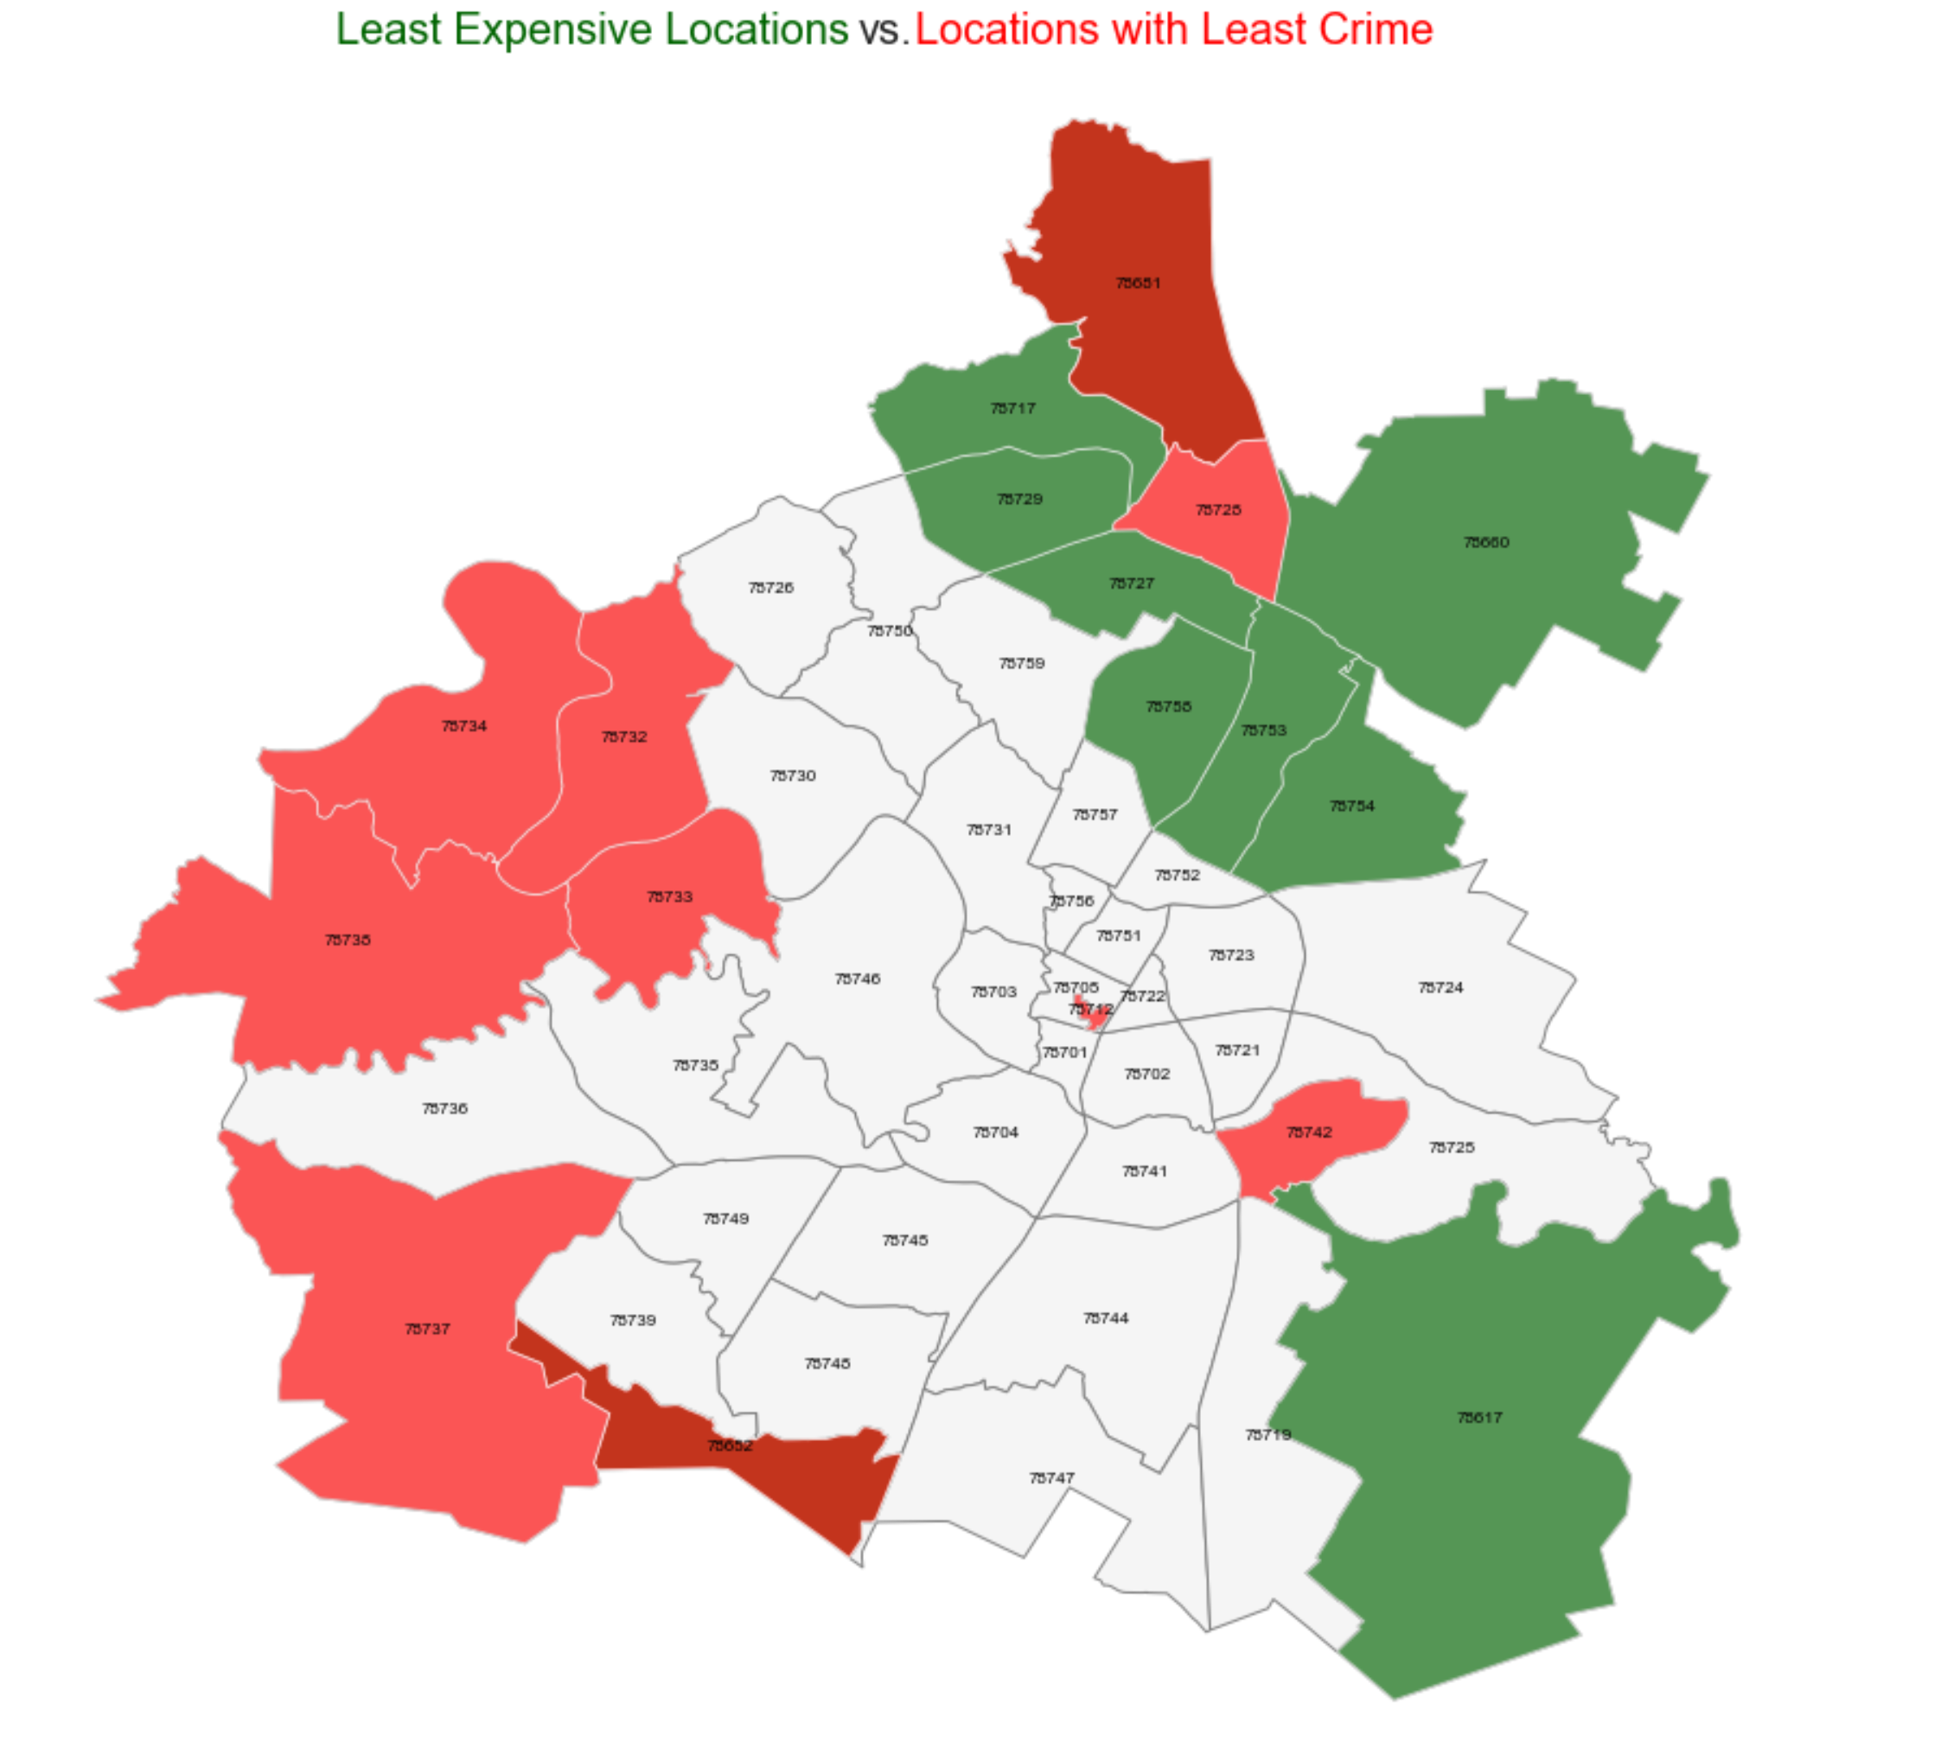
Exploratory Data Analysis

Slide 22
Inferential Statistics
Testing if the target variable price follows a normal distribution
This is to identify if parametric testing or nonparametric testing is to be used:
Null Hypothesis: The price distribution is normal
Alternative Hypothesis: The price distribution is not normal
Kolmogorov-Smirnov testing is used:
Alpha: 0.05
KS-Statistic: 0.227; P-Value: 0.000000
P-Value larger than alpha? False
The price curve does not appear normal (null hypothesis is rejected) – nonparametric stats testing to be used

Slide 23
Inferential Statistics
Objective is to test correlation of major crimes and price
But first, assumption of homogeneity of variances is tested
This is to identify if Pearson coefficient or Spearman ranking is to be used:
Null Hypothesis: There is homoscedasticity between major crimes and price
Alternative Hypothesis: There is no homoscedasticity between major crimes and price
Levene’s test is used:
Alpha: 0.05
Levene W: 29318.802; P-Value: 0.000000
P-Value larger than alpha? False
Assumption of homogeneity is violated (null hypothesis is rejected) – to use Spearman ranking

Slide 24
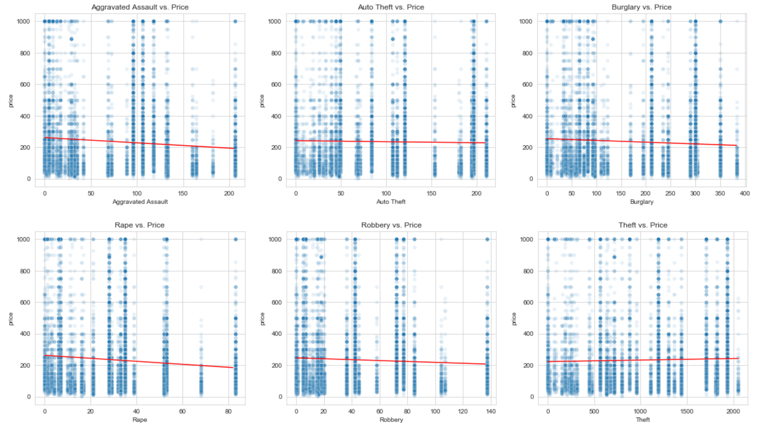
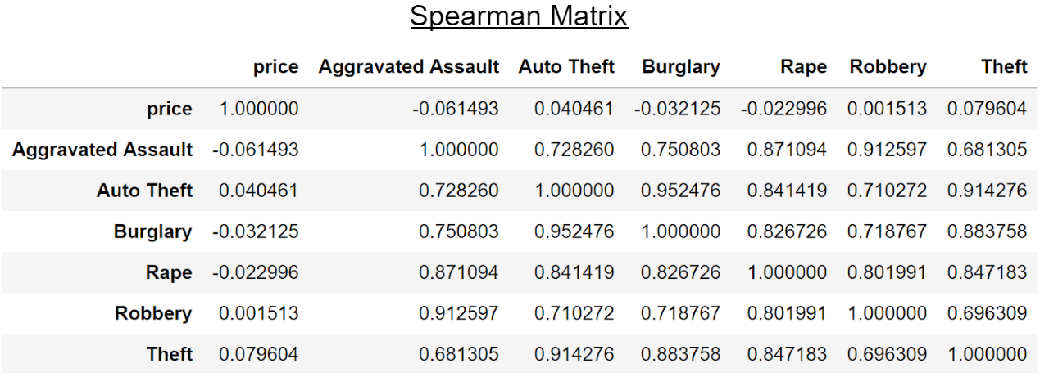
Inferential Statistics
Very weak correlation between major crimes and price per Spearman rank
However, major crimes highly correlate with each other, suggesting that the presence of one crime in an area would likely exhibit the presence of another

Slide 25
Inferential Statistics
Objective is to test correlation of some categorical features and price
Null Hypothesis: The distributions for the category are similar
Alternative Hypothesis: The distributions for the category are not similar
Mann-Whitney U test is used because the price curve is nonparametric
As an example, Family-friendly is tested:
Mann-Whitney U: 12680419.000; P-Value: 0.000000
P-Value larger than alpha? False
This feature has categories that have distinct distributions from one another (null hypothesis is rejected)
This suggests that this feature is good to use in our model

Slide 26
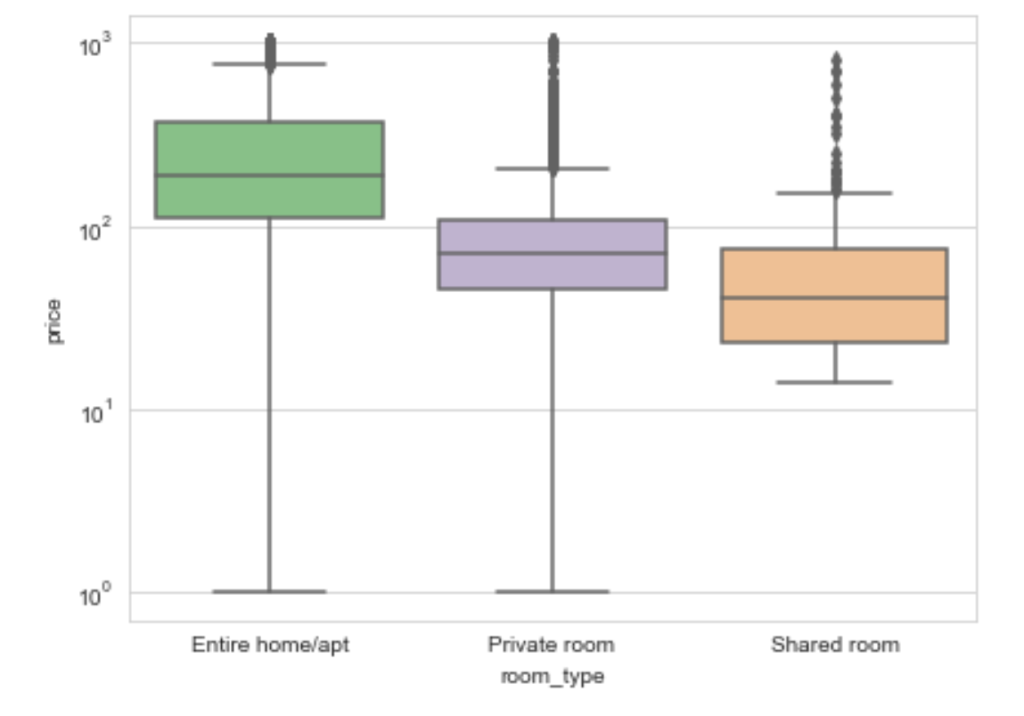
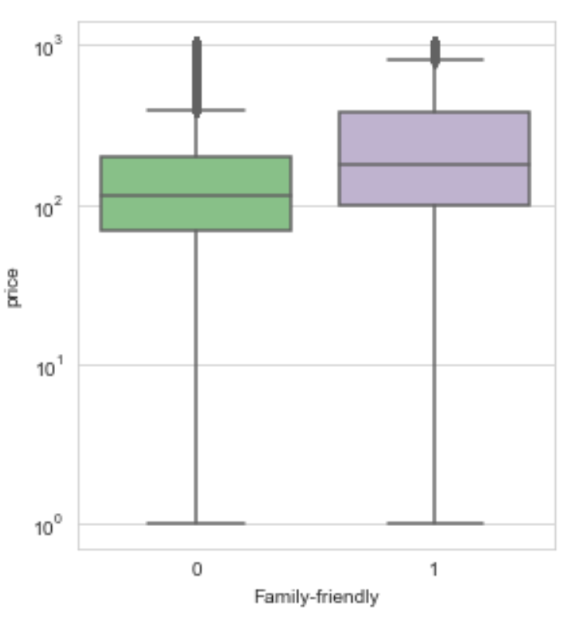
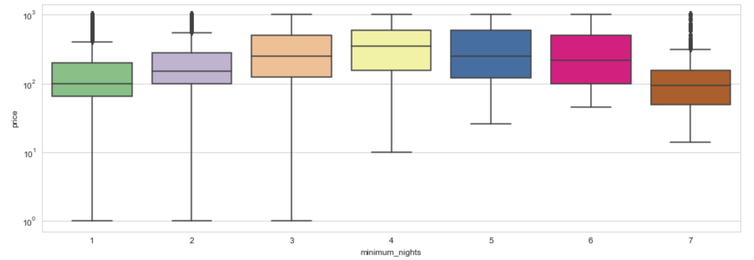
Inferential Statistics

Slide 27
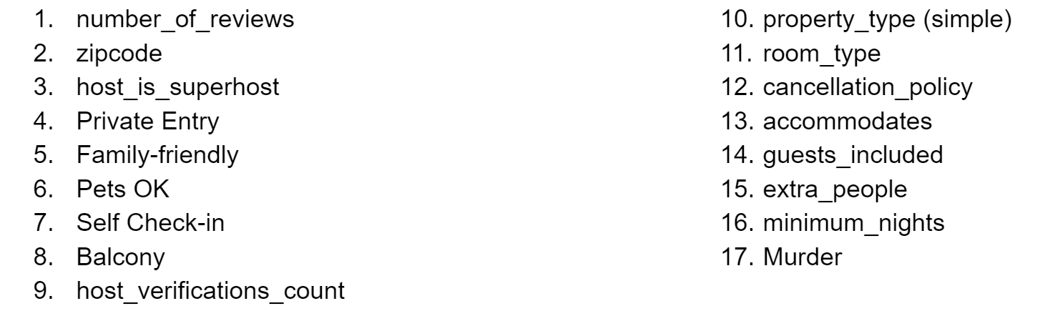
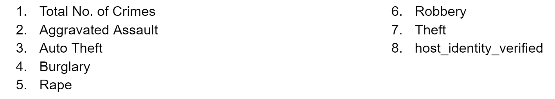
Inferential Statistics
Features that have been shown to be statistically useful for our model:
Features that are not considered statistically useful for our model:

Slide 28
Machine Learning
Categorical X features were manually converted into categories datatype
This is because numerical features like zipcode appear continuous even though they are discrete
Continuous features were scaled using StandardScaler
Categorical features were transformed using One Hot Encoding through Panda’s get_dummies

Slide 29
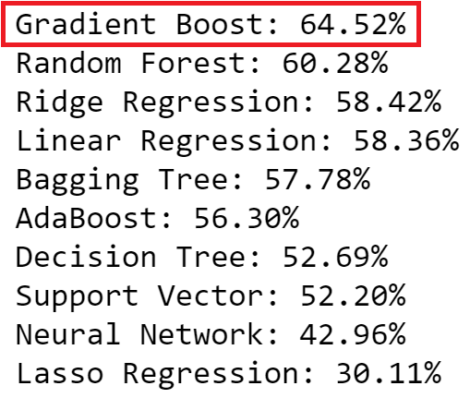
Machine Learning
Using R² accuracy as the metric, Gradient Boosting achieved the highest 5-fold cross-validation mean across different untuned (default) estimators

Slide 30
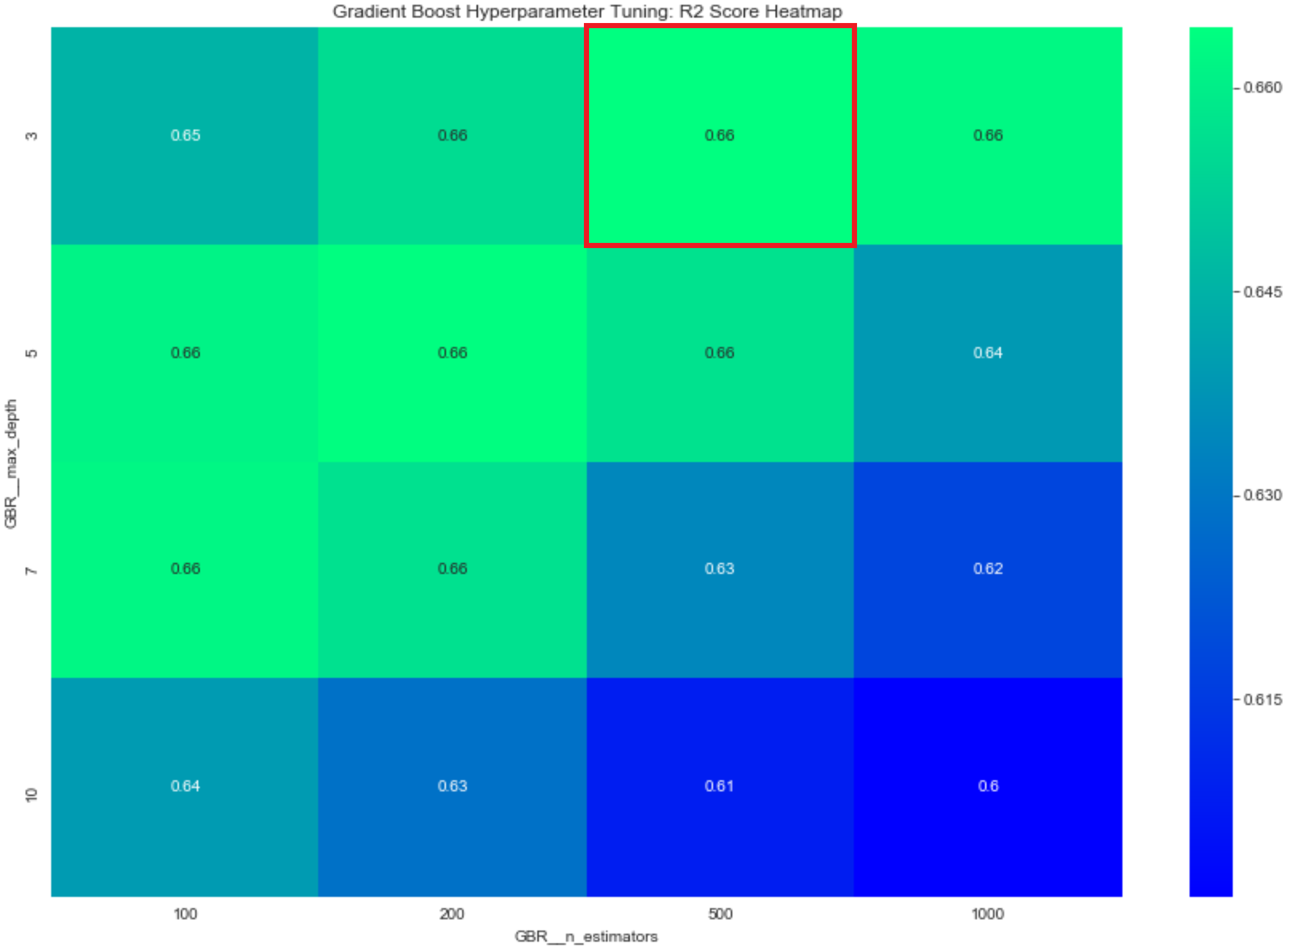
Machine Learning
At 66.44%, the result on the training set improved slightly when the maximum depth and the number of estimators were tuned.

Slide 31
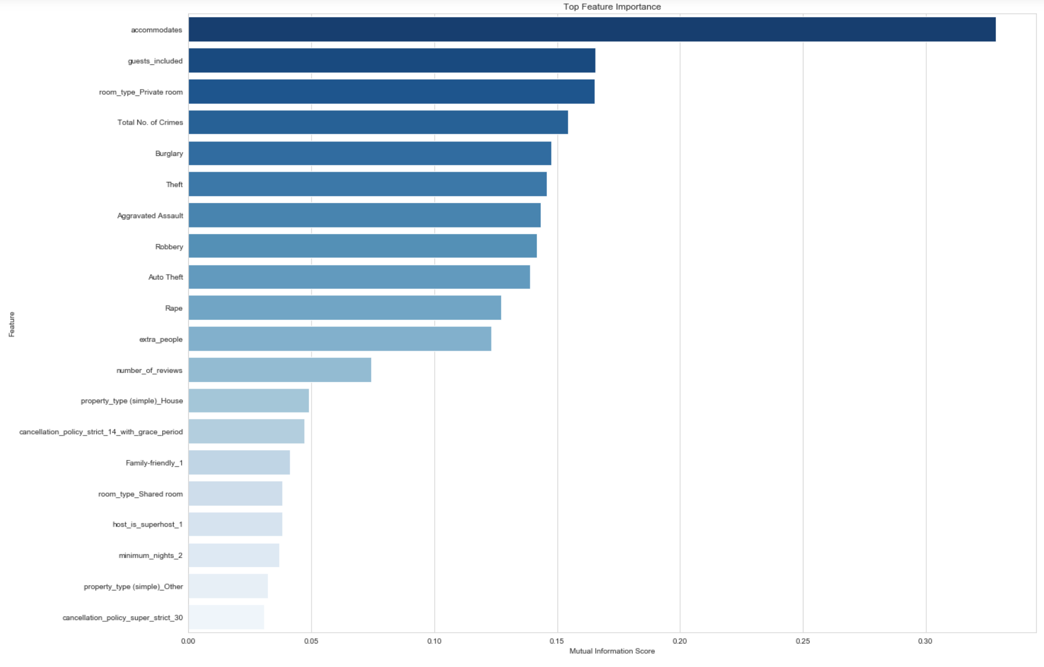
Machine Learning
Using Mutual Information regression, the features were ranked by importance

Slide 32
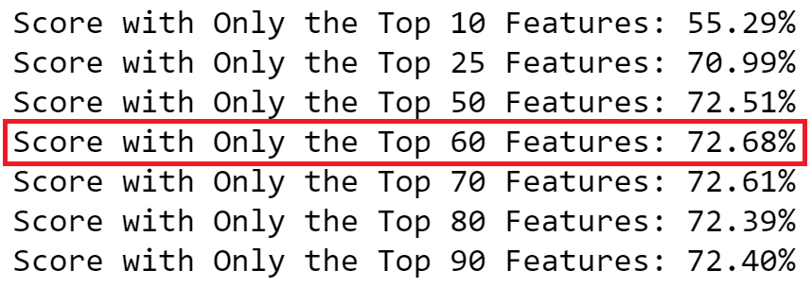
Machine Learning
The model was ran on only the top N features
Performance was best when the top 60 features are used, though the gain after 25 features is slight
This simplifies the model by reducing the number of dimensions

Slide 33
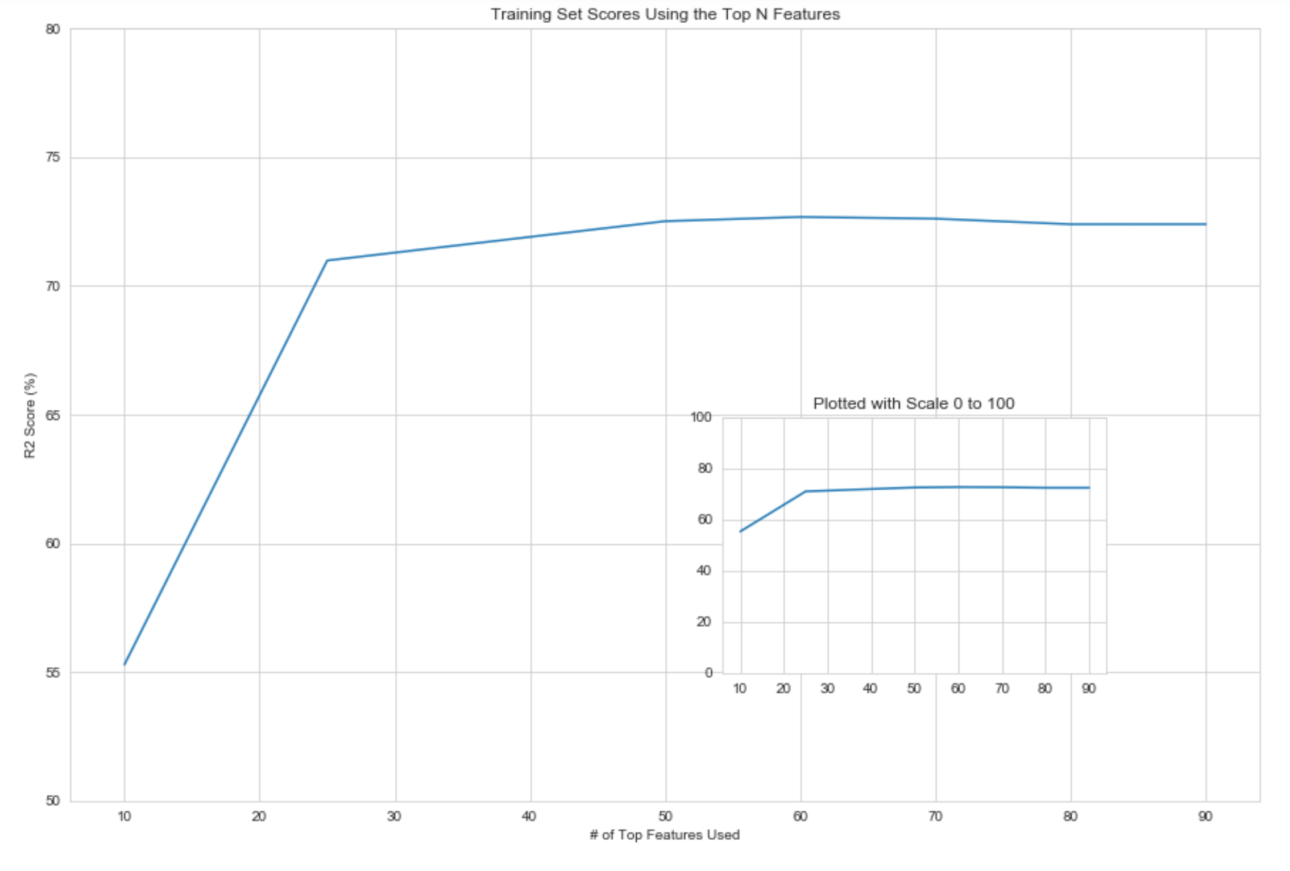
Machine Learning

Slide 34
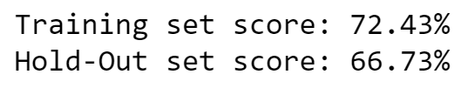
Final Score
The model has been optimized using the best estimator tuned with the best parameters
Feature selection has also been done to improve accuracy
The hold-out set was put aside after performing the train-test split
There is a delta between the training set score and the hold-out set score

Slide 35
Conclusion
Hold-out set score represents how well the predictive model can perform on any given set of inputs
Improvement on the training set score did not translate to a higher hold-out set score
The techniques applied are still justified because they reduce the risk of the curse of dimensionality
Fewer features (only 2/3 of the original feature count) have made the model less complex
Any further improvement may also risk overfitting the training data
The model is simple, fast, and has acceptable accuracy

Slide 36
Recommendations
Construct a holistic pipeline that begins with scraping the most recent datasets using requests and BeautifulSoup, feeding them to a ColumnTransformer that utilizes the Imputer for continuous features, and the OneHotEncoder for discrete features
Pipeline should also consider clipping the outliers by percentile
Make use of Model Stacking, where multiple regression techniques can be chained to boost the accuracy
Use deep learning along with XGBoost and/or LightGBM approach

